Slide 1
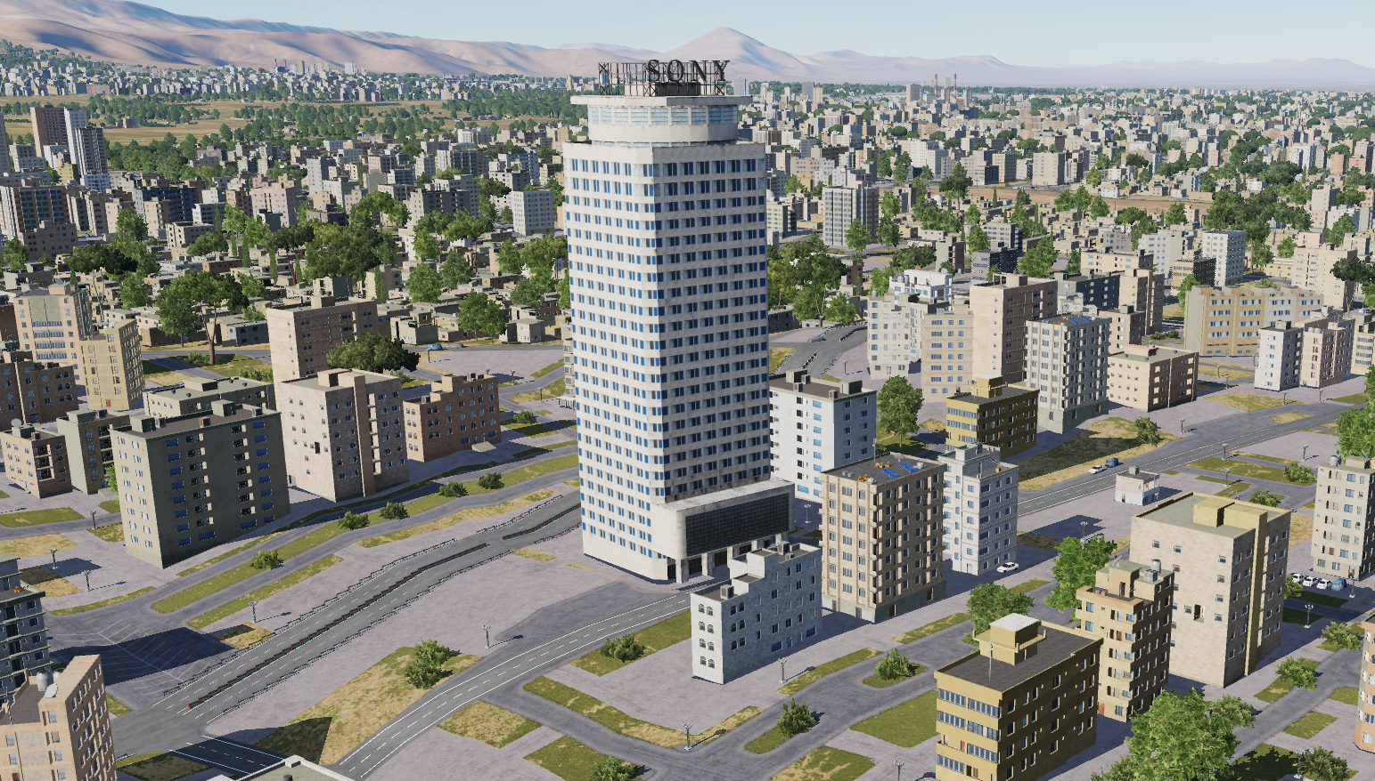
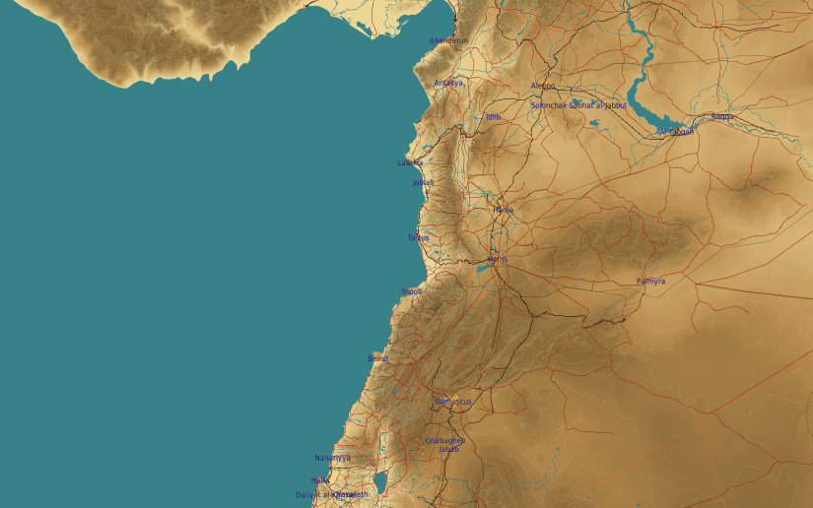
SYTGT070 Syrian Broadcasting Headquarter
1
N
70
DESCRIPTION OF THE DESIRED POINTS OF IMPACT WITH WPN TYPE:
SYTGT070A – Syrian Broadcasting HQ
DPI N33 30.812 E036 17.770/2264ft/(2000 Ibs bomb)
SYTGT070A – 25 storey building, poured concrete roof and floors supported by reinforced concrete pillars. Requires delayed fuzing.
Suggested fuzing solution on DPI 1 – Delayed fuzing to reach down into the building, 85 degree impact angle.
4
5
6
Collateral damage concerns within 25 meters in all directions.
7
8

